Slide 1
Detection Chronic Kidney Disease Using Deep Learning

Slide 2
INDEX
    Abstract
    Objective of project
    Problem Statement
    Scope & Motivation
    Introduction
    Literature survey
    Existing Method
    Disadvantages
    Proposed method
    Advantages
    Project Flow
    Hardware and Software Requirements
    Architecture
    Modules
    UML Diagram
    Output Screens
    Conclusion
    Future Work
    References

Slide 3
ABSTRACT
Chronic kidney disease (CKD) is a global health issue that causes a high incidence of morbidity and death, as well as the onset of additional illnesses. Because there are no clear symptoms in the early stages of CKD, people frequently miss it. Early identification of CKD allows patients to obtain prompt therapy to slow the disease's development. Due of their rapid and precise identification capabilities, deep learning models can successfully assist doctors in achieving this aim. We present a machine-learning framework for diagnosing CKD in this paper. The CKD data set was collected from the deep learning repository at the University of California, Irvine (UCI). As a result, it will determine whether or not a patient has CKD and, if so, whether or not further drugs should be taken. Deep learning algorithms (CNN, Mobile net and kidney disease) were used to establish models. Among these deep learning models, random forest achieved the best accuracy. By analyzing the misjudgments generated by the established models, we proposed an integrated model that combines logistic regression and random forest by using perceptron, best accuracy hence; we speculated that this methodology could be applicable to more complicated clinical data for disease diagnosis.
Keywords: - CNN, Mobile net and kidney chronic disease.

Slide 4
    OBJECTIVE OF PROJECT
The objective of this study is to develop a deep learning-based model for the early detection and diagnosis of chronic kidney disease (CKD). Leveraging medical data, this research aims to create an accurate and efficient system capable of predicting CKD risk factors, thereby facilitating timely intervention and improved patient outcomes.

Slide 5
    PROBLEM STATEMENT
The problem is to develop a deep learning-based model for the early detection of chronic kidney disease (CKD). This model should analyze patient data, including clinical measurements, medical history, and laboratory test results, to accurately predict the presence of CKD. Early detection is crucial for timely intervention and prevention of CKD progression, which can lead to severe health complications. The goal is to create an efficient and reliable tool to assist healthcare providers in diagnosing CKD at an earlier stage, improving patient outcomes and reducing healthcare costs.

Slide 6
    SCOPE AND MOTIVATION
The scope of detecting chronic kidney disease using deep learning encompasses leveraging advanced neural networks and medical data to develop accurate predictive models. This includes early diagnosis, risk assessment, and treatment optimization, contributing to improved patient care, reduced healthcare costs, and enhanced overall public health through proactive CKD management.

Slide 7
    SCOPE AND MOTIVATION
Detecting Chronic Kidney Disease through Deep Learning is not just a scientific endeavor; it's a path to saving lives. By harnessing the power of artificial intelligence, we empower healthcare professionals with rapid, accurate diagnoses, enabling early intervention and improving patient outcomes. With every line of code and every data point analyzed, we contribute to a future where individuals can lead healthier lives, reducing the burden of this silent but deadly disease on global healthcare systems. This pursuit is not just about technology; it's about the profound impact it can have on human health and well-being.

Slide 8
    INTRODUCTION
Chronic Kidney Disease (CKD) is a global healthcare concern with a steadily increasing prevalence. It poses significant challenges for both patients and healthcare systems due to its often asymptomatic nature in the early stages and potential for severe complications, including end-stage renal disease. Early detection and timely intervention are crucial to slow the progression of CKD and improve patient outcomes. Traditional diagnostic methods rely on laboratory tests, which may not always be accessible or cost-effective.
In recent years, Deep Learning (DL) techniques have shown immense promise in revolutionizing medical diagnostics, including the identification of CKD. DL models, such as Convolutional Neural Networks (CNNs) and Recurrent Neural Networks (RNNs), excel at extracting complex patterns and features from medical data, such as patient records, medical images, and genetic information. These models have the potential to enhance CKD detection by analyzing a multitude of factors and providing accurate predictions. This paper explores the application of DL in the early detection of CKD, emphasizing its potential to transform healthcare by facilitating proactive and personalized care for individuals at risk of this debilitating condition.

Slide 9
    LITERATURE SURVEY
S.NO | YEAR | AUTHORS | TITLE | OUT COMES
1 | 2018 | Tang, J., Liu, R., Zhang | Deep Learning for Kidney Tissue Classification | A type of deep learning architecture known for its effectiveness in image analysis tasks, to tackle the challenging problem of kidney tissue classification
2 | 2019 | Jirayucharoensak, S., Pan-Ngum, S., & Israsena | Automatic kidney disease diagnosis from ultrasound images using deep convolutional neural networks | Kidney disease is a prevalent health issue, and early detection is crucial for effective treatment and management. Traditional diagnosis methods can be time-consuming and subjective, making the need for automated and accurate diagnostic tools essential

Slide 10
    LITERATURE SURVEY
S.NO | YEAR | AUTHORS | TITLE | OUT COMES
3 | 2018 | Liang, M., Ni, Z., & Yan | Chronic kidney disease classification using deep convolutional neural networks | In this research, the authors leveraged the power of deep convolutional neural networks (CNNs), a type of deep learning model well known for its effectiveness in image classification tasks.
4 | 2018 | Islam, M. T., Rahman, M. M., Islam | Kidney disease classification from ultrasonic images using deep convolutional neural networks | The primary objective of this research was to develop an automated and accurate method for classifying kidney diseases based on ultrasound images, which are widely used in clinical practice due to their non-invasive nature

Slide 11
    EXISTING SYSTEM
Using training data set required Model is trained and tested. Respective Algorithm is they used along with trained model for CKD detection. As an Input, patient input parameter is given in system. Figures are analyzed using deep learning technique and diagnosis is done.
Disadvantages:
  1. High complexity.
  2.Time consuming.

Slide 12
PROPOSED METHOD
We are performing classification of either detecting chronic disease using Convolution Neural Network (CNN) and MobileNet of deep learning along with machine learning methods in the purposed method. As image analysis-based approaches for detecting kidney disease. As a result, proper classification is essential for proper treatment, which will be possible with our proposed method
Advantages:
  Highest Accuracy
  2Reduces Time Complexity

Slide 13
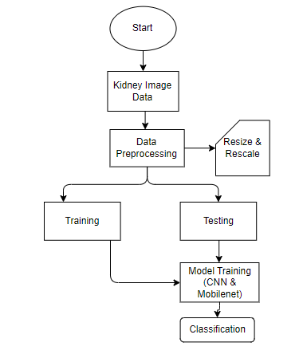
PROJECT FLLOW
Figure: work Flow of Proposed system

Slide 14
HARDWARE & SOFTWARE REQUIREMENTS
SOFTWARE REQUIREMENS
Operating System : Windows 7/8/10
Server side Script : HTML, CSS, Bootstrap & JS
Programming Language : Python
Libraries : Flask, Pandas, Mysql.connector, Os, Smtplib, Numpy
IDE/Workbench : PyCharm
Technology : Python 3.6+
Server Deployment : Xampp Server
Database : MySQL

Slide 15
HARDWARE & SOFTWARE REQUIREMENTS
HARDWARE REQUIREMENTS
Processor - I3/Intel Processor
RAM - 8GB (min)
Hard Disk - 128 GB
Key Board - Standard Windows Keyboard
Mouse - Two or Three Button Mouse
Monitor - Any

Slide 16
FUNCTIONAL AND NON-FUNCTIONAL REQUIREMENTS
Requirement’s analysis is very critical process that enables the success of a system or software project to be assessed. Requirements are generally split into two types: Functional and non-functional requirements.
Functional Requirements: These are the requirements that the end user specifically demands as basic facilities that the system should offer. All these functionalities need to be necessarily incorporated into the system as a part of the contract. These are represented or stated in the form of input to be given to the system, the operation performed and the output expected. They are basically the requirements stated by the user which one can see directly in the final product, unlike the non-functional requirements.

Slide 17
FUNCTIONAL AND NON-FUNCTIONAL REQUIREMENTS
Examples of functional requirements:
Authentication of user whenever he/she logs into the system
System shutdown in case of a cyber-attack
A verification email is sent to user whenever he/she register for the first time on some software system.
Non-functional requirements: These are basically the quality constraints that the system must satisfy according to the project contract. The priority or extent to which these factors are implemented varies from one project to other. They are also called non-behavioral requirements.

Slide 18
    UML DIAGRAMS
Use Case Diagram:
A use case diagram in the Unified Modeling Language (UML) is a type of behavioral diagram defined by and created from a Use-case analysis. Its purpose is to present a graphical overview of the functionality provided by a system in terms of actors, their goals (represented as use cases), and any dependencies between those use cases. The main purpose of a use case diagram is to show what system functions are performed for which actor. Roles of the actors in the system can be depicted.

Slide 19
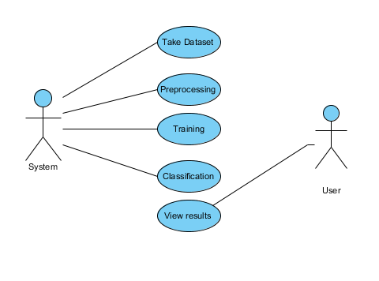
    UML DIAGRAMS
Figure: Use Case Diagram

Slide 20
    UML DIAGRAMS
Class Diagram:
In software engineering, a class diagram in the Unified Modelling Language (UML) is a type of static structure diagram that describes the structure of a system by showing the system's classes, their attributes, operations (or methods), and the relationships among the classes. It explains which class contains information.

Slide 21
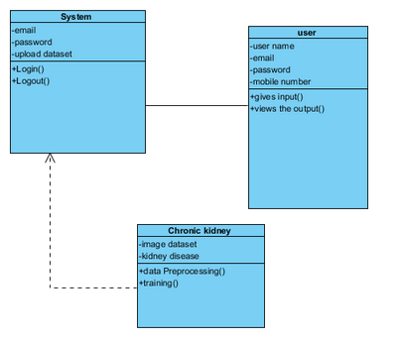
    UML DIAGRAMS
Figure: Class diagram

Slide 22
    UML DIAGRAMS
Sequence Diagram:
A sequence diagram in Unified Modelling Language (UML) is a kind of interaction diagram that shows how processes operate with one another and in what order. It is a construct of a Message Sequence Chart. Sequence diagrams are sometimes called event diagrams, event scenarios, and timing diagrams.

Slide 23
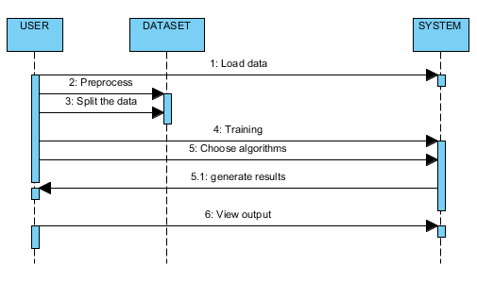
    UML DIAGRAMS
Figure: Sequence diagram

Slide 24
    UML DIAGRAMS
Collaboration Diagram:
In collaboration diagram the method call sequence is indicated by some numbering technique as shown below. The number indicates how the methods are called one after another. We have taken the same order management system to describe the collaboration diagram. The method calls are similar to that of a sequence diagram. But the difference is that the sequence diagram does not describe the object organization whereas the collaboration diagram shows the object organization.

Slide 25
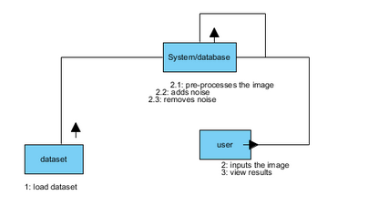
    UML DIAGRAMS
Figure: Collaboration diagram

Slide 26
    UML DIAGRAMS
Deployment Diagram
Deployment diagram represents the deployment view of a system. It is related to the component diagram. Because the components are deployed using the deployment diagrams. A deployment diagram consists of nodes. Nodes are nothing but physical hardware’s used to deploy the application.

Slide 27
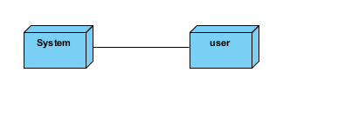
    UML DIAGRAMS
Figure: Deployment diagram

Slide 28
    UML DIAGRAMS
Activity Diagram:
Activity diagrams are graphical representations of workflows of stepwise activities and actions with support for choice, iteration and concurrency. In the Unified Modelling Language, activity diagrams can be used to describe the business and operational step-by-step workflows of components in a system. An activity diagram shows the overall flow of control.

Slide 29
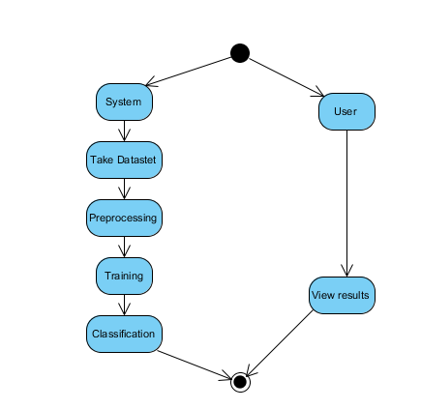
    UML DIAGRAMS
Figure: Activity diagram

Slide 30
    UML DIAGRAMS
Component Diagram:
A component diagram, also known as a UML component diagram, describes the organization and wiring of the physical components in a system. Component diagrams are often drawn to help model implementation details and double-check that every aspect of the system's required functions is covered by planned development.

Slide 31
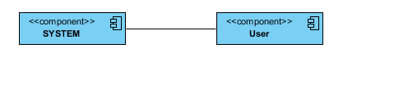
    UML DIAGRAMS
Figure: Component diagram

Slide 32
    UML DIAGRAMS
ER Diagram:
An Entity–relationship model (ER model) describes the structure of a database with the help of a diagram, which is known as Entity Relationship Diagram (ER Diagram). An ER model is a design or blueprint of a database that can later be implemented as a database. The main components of E-R model are: entity set and relationship set.
An ER diagram shows the relationship among entity sets. An entity set is a group of similar entities and these entities can have attributes. In terms of DBMS, an entity is a table or attribute of a table in database, so by showing relationship among tables and their attributes, ER diagram shows the complete logical structure of a database. Let’s have a look at a simple ER diagram to understand this concept.

Slide 33
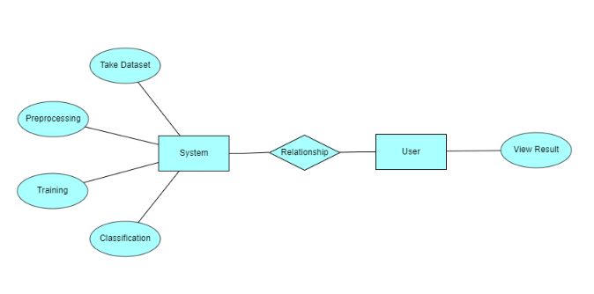
    UML DIAGRAMS
Figure: ER diagram

Slide 34
    UML DIAGRAMS
DFD Diagram:
A Data Flow Diagram (DFD) is a traditional way to visualize the information flows within a system. A neat and clear DFD can depict a good amount of the system requirements graphically. It can be manual, automated, or a combination of both. It shows how information enters and leaves the system, what changes the information and where information is stored. The purpose of a DFD is to show the scope and boundaries of a system as a whole. It may be used as a communications tool between a systems analyst and any person who plays a part in the system that acts as the starting point for redesigning a system.

Slide 35
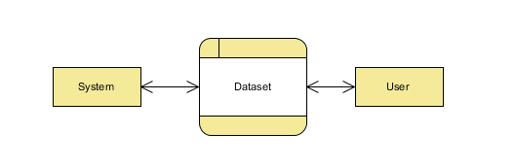
    UML DIAGRAMS
Figure: Context Level diagram

Slide 36
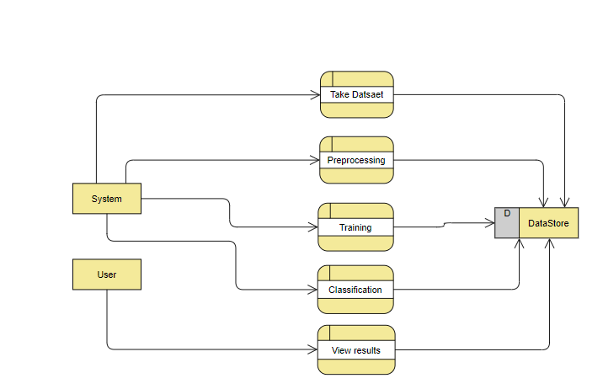
    UML DIAGRAMS
FigureLevel-1 diagram

Slide 37
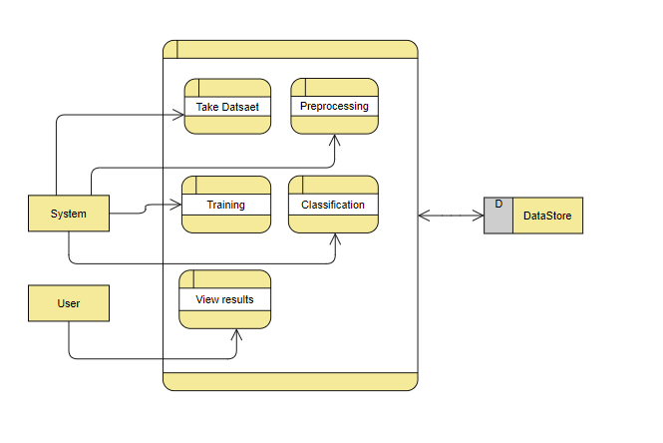
    UML DIAGRAMS
Figure:Level-2 diagram

Slide 38
IMPLEMENTATION AND RESULTS
1. System:
1.1 Create Dataset:
Collect a diverse dataset of retinal images, including images with and without signs of cardiovascular disease.
Split the dataset into two parts: a training dataset (used for model training) and a testing dataset (used to evaluate the model's performance). The test dataset should typically be around 20-30% of the total dataset.
1.2 Pre-processing:
Before feeding images into the deep learning model, perform pre-processing steps like resizing and reshaping to ensure all images are in a consistent format.
Normalize pixel values, and potentially augment the data with techniques like rotation, flipping, or contrast adjustments to improve model generalization.

Slide 39
IMPLEMENTATION AND RESULTS
1. System:
1.3 Training:
Train a deep learning model using the pre-processed training dataset. Common architectures for image classification include Convolutional Neural Networks (CNNs).
During training, the model learns to recognize patterns and features in the retinal images that distinguish between disease and normal cases.
Utilize loss functions and optimization algorithms to fine-tune the model's parameters.
1.4 Classification:
After training, use the trained model to classify new, unseen retinal images as either "with disease" or "normal."
The classification output could be a probability score or a binary decision, indicating the likelihood of the image containing signs of cardiovascular disease.

Slide 40
IMPLEMENTATION AND RESULTS
2.1 Upload Image:
Provide a user-friendly interface where users can upload their retinal images for classification.
Ensure the system can handle various image formats and sizes.
2.2 View Results:
Once the trained model processes the uploaded image, display the results to the user.
Results could include a textual description (e.g., "No disease detected" or "Possible disease detected") and, optionally, a visualization of the image with highlighted regions of interest.
Users should be able to easily interpret and understand the classification results

Slide 41

HOME PAGE:

Slide 42
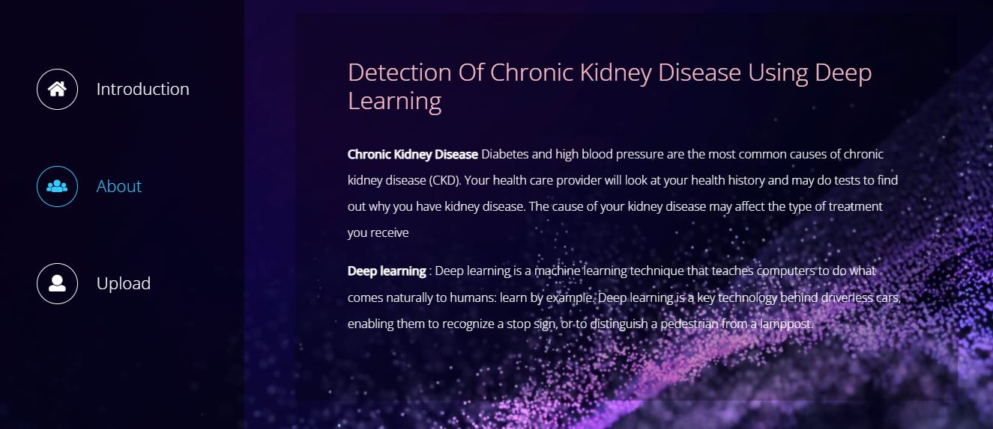
ABOUT PAGE:

Slide 43

UPLOAD PAGE:

Slide 44
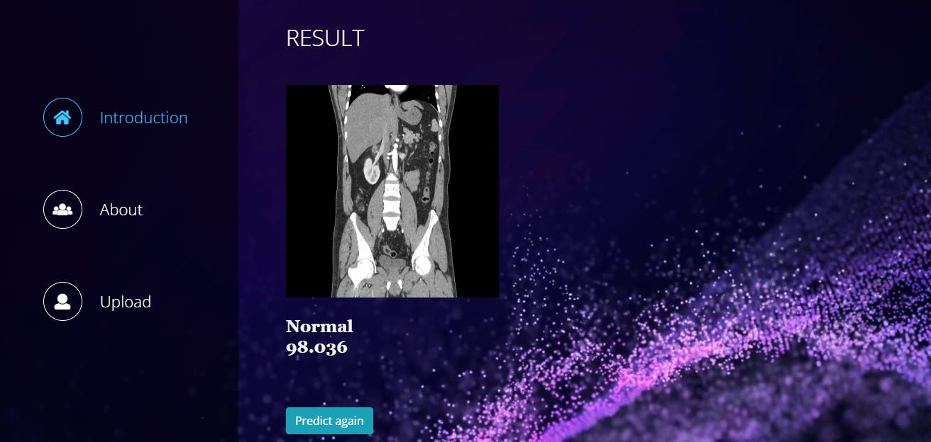
RESULT PAGE:

Slide 45
    CONCLUSION
In terms of data imputation and sample diagnosis, the suggested CKD diagnostic approach is practical. The integrated model could obtain adequate accuracy after unsupervised imputation of missing values in the data set using Mobile net imputation. As a result, we believe that applying this technique to the practical diagnosis of CKD will have a positive outcome. Furthermore, this technology might be used to clinical data from various disorders in real-world medical diagnosis. However, because of the restrictions of the conditions, the available data samples are relatively small throughout the model's development; the model's generalization performance may be limited. Furthermore, because there are only four types of data samples in the data (ckd and not ckd), set, and the model cannot diagnose the severity of CKD.

Slide 46
    FUTURE ENHANCEMENT
In the future, a large number of more complex and representative data will be collected to train the model to improve the generalization performance while enabling it to detect the severity of the disease. We believe that this model will be more and more perfect by the increase of size and quality of the data.

Slide 47
REFERENCES
1. Tang, J., Liu, R., Zhang, Y. et al. (2018). "DeepKidney: Deep Learning for Kidney Tissue Classification." Scientific Reports, 8(1), 1-9. DOI: 10.1038/s41598-018-22549-w.
2. Jirayucharoensak, S., Pan-Ngum, S., & Israsena, P. (2019). "Automatic kidney disease diagnosis from ultrasound images using deep convolutional neural networks." Journal of Digital Imaging, 32(3), 469-478. DOI: 10.1007/s10278-018-0137-4.
3. Liang, M., Ni, Z., & Yan, P. (2018). "Chronic kidney disease classification using deep convolutional neural networks." Multimedia Tools and Applications, 77(12), 16083-16093. DOI: 10.1007/s11042-018-5992-2.
4. Islam, M. T., Rahman, M. M., Islam, M. Z., & Zhang, Y. (2018). "Kidney disease classification from ultrasonic images using deep convolutional neural networks." Journal of Ambient Intelligence and Humanized Computing, 9(4), 989-999. DOI: 10.1007/s12652-017-0571-1.

